Slide 1



Presented by:
Perchance

Slide 2




EFFORTLESS TRAFFIC PLANNING
Traffic simulator

Slide 3






Fully interactive
Real-time visuals
For our builders
EFFORTLESS TRAFFIC PLANNING

Slide 4





Slide 5







IDM + MOBIL
Vehicle Behaviour Simulation
EFFORTLESS TRAFFIC PLANNING
Lane
changes
Acceleration
changes
Vehicle recognition
Obstacle
recognition

Slide 6



Heat map
Traffic overview
EFFORTLESS TRAFFIC PLANNING
Highlighted
Congestions
Flow
density

Slide 7



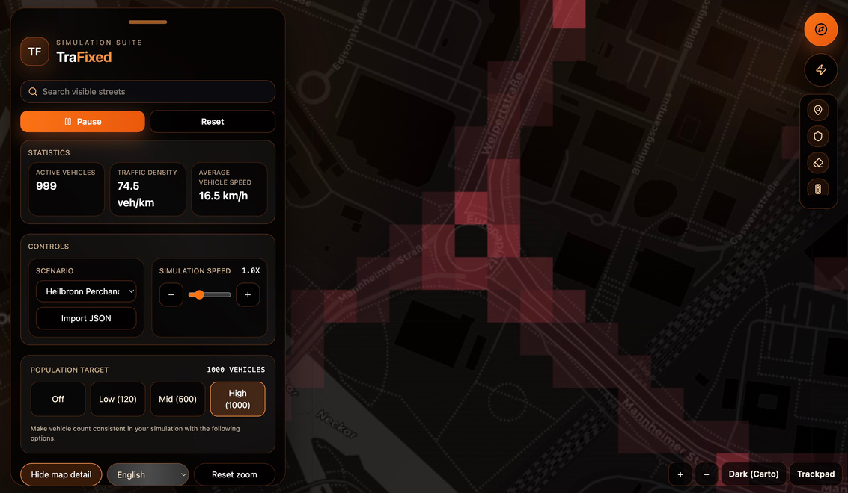
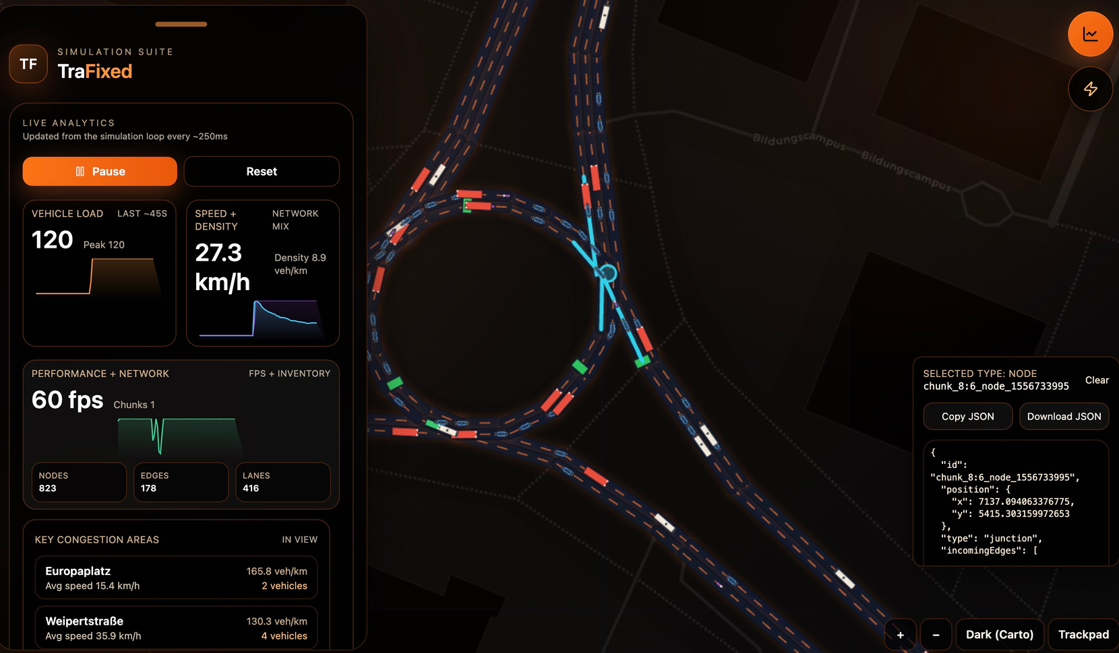
EFFORTLESS TRAFFIC PLANNING
Load any city instantly
High-precision map

Slide 8



Live Demo

Slide 9




Slide 10






Solutions
Fast
EFFORTLESS TRAFFIC PLANNING
Scalable
Data-driven
Growing City

Slide 11







Slide 12




WELL-ROUNDED
TECHNICALLY DEEP
SCALABLE
PRACTICAL
FAST TO USE
EFFORTLESS TRAFFIC PLANNING

Slide 13





Slide 14





EFFORTLESS TRAFFIC PLANNING
LIM YONG LAM
AHMED NOUICER
KAIHAN SABA
IVANA GUZMAN
ZACHARY HOOSER
TAN KAYA EROL

